Slide 1
TASK 3
ASSIGNMENT RULES,SLA REQUIREMENTS,REPORTS& DASHBOARDS

Slide 2
Assignment rules:
—--------------------------------
1. Check the existing Priority lookup rules for both incident and problem table.
2. Delete the existing Priority lookup rules and create the rules again for priority.
3. Add new choices for the impact fields - very high and very low create few new rules based on new choices in the incident.
4. Create new assignment look up rule for Brillio parent table matcher fields are - Category, designation and Assignment group and assigned to should be matcher fields.
5. Research on Exact lookup match field.
6.Create assignment rules for the incident table based on impact and Configuration item.
7.Explore the run on form change, insert , update in the data lookup definition.
SLA Requirements:
Test whether we can design SLA for a Custom table.
SLA for Hardware - hardware group - priority 1 - Pause on onhold - Stop on Resolved/Closed - (8-15)hongkong - 2 hours
SLA for Hardware - hardware group - priority 2 - Pause on onhold - Stop on Resolved/Closed - (8-15)hong kong - 4 hours
SLA for Hardware - hardware group - priority 3 - Pause on onhold - Stop on Resolved/Closed - (8-15)hongkong- 8 hours
SLA for Hardware - hardware group - priority 4 - Pause on onhold - Stop on Resolved/Closed - (8-15)hongkong- 16 hours
SLA for Capacity Mgmt - Capacity management- Priority 1 - Pause on onhold - Stop on Resolved/Closed - (10-17) US/central - 1 hours
SLA for Capacity Mgmt - Capacity management - Priority 2 - Pause on onhold - Stop on Resolved/Closed - (10-17) US/central - 3 hours
SLA for Capacity Mgmt - Capacity management - Priority 2 - Pause on onhold - Stop on Resolved/Closed - (10-17) US/central - 7 hours
SLA for Capacity Mgmt - Capacity management - Priority 2 - Pause on onhold - Stop on Resolved/Closed - (10-17) US/central - 18 hours
SLA for Help Desk - Helpdesk - Priority 1 - Pause on onhold - Stop on resolved/closed - (9-16) Europe/Brussels- 4 Hours
SLA for Help Desk - Helpdesk - Priority 2 - Pause on onhold - Stop on resolved/closed - (9-16) Europe/Brussels - 6 Hours
SLA for Help Desk - Helpdesk - Priority 3- Pause on onhold - Stop on resolved/closed - (9-16) Europe/Brussels- 8 Hours
SLA for Help Desk - Helpdesk - Priority 4 - Pause on onhold - Stop on resolved/closed - (9-16) Europe/Brussels - 10 Hours
SLA for Help Desk - Helpdesk- Priority 5 - Pause on onhold - Stop on resolved/closed - (9-16) Europe/Brussels - 2 days

Slide 3
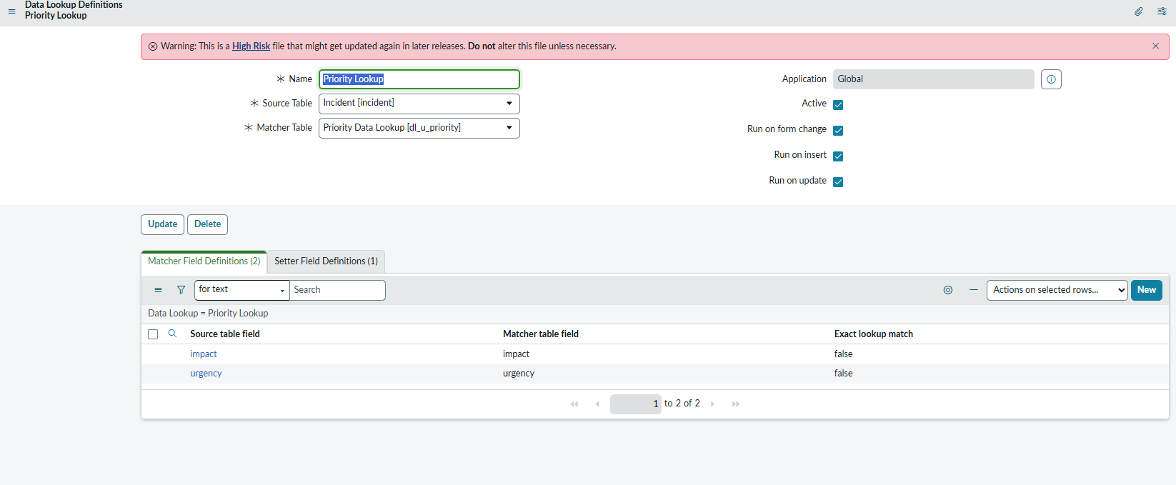
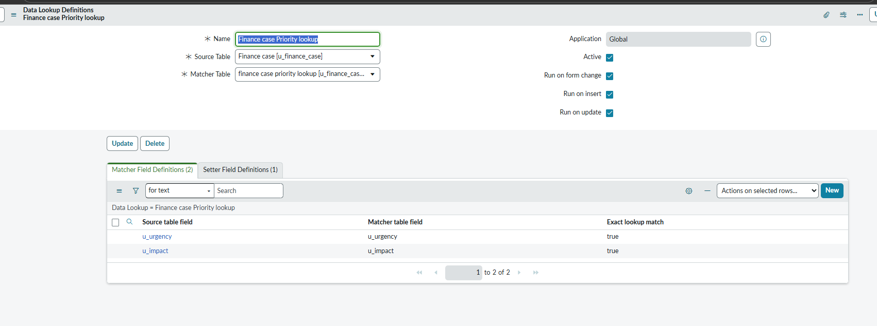
DATA LOOKUP RULES AND ASSIGNMENTS RULES Check the existing Priority lookup rules for both incident and problem table. 2. Delete the existing Priority lookup rules and create the rules again for priority. Add new choices for the impact fields - very high and very low create few new rules based on new choices in the incident.

Slide 4
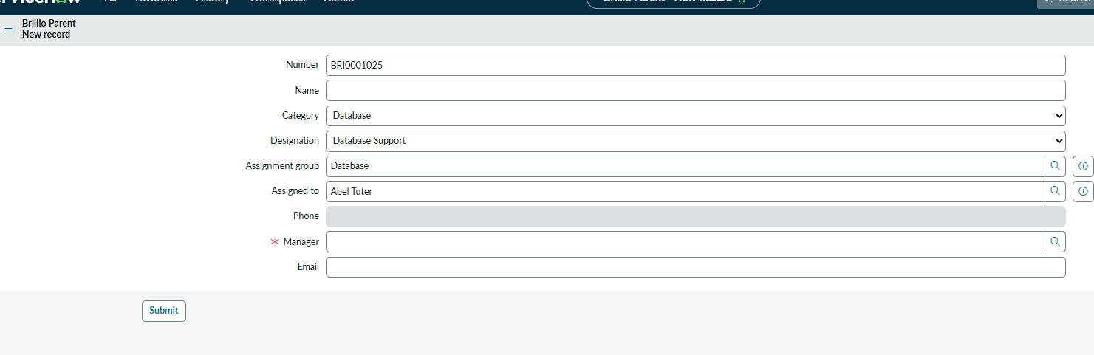
Brillio data look up we are autopopulating the assignment group Explore the run on form change, insert , update in the data lookup definition.

Slide 5
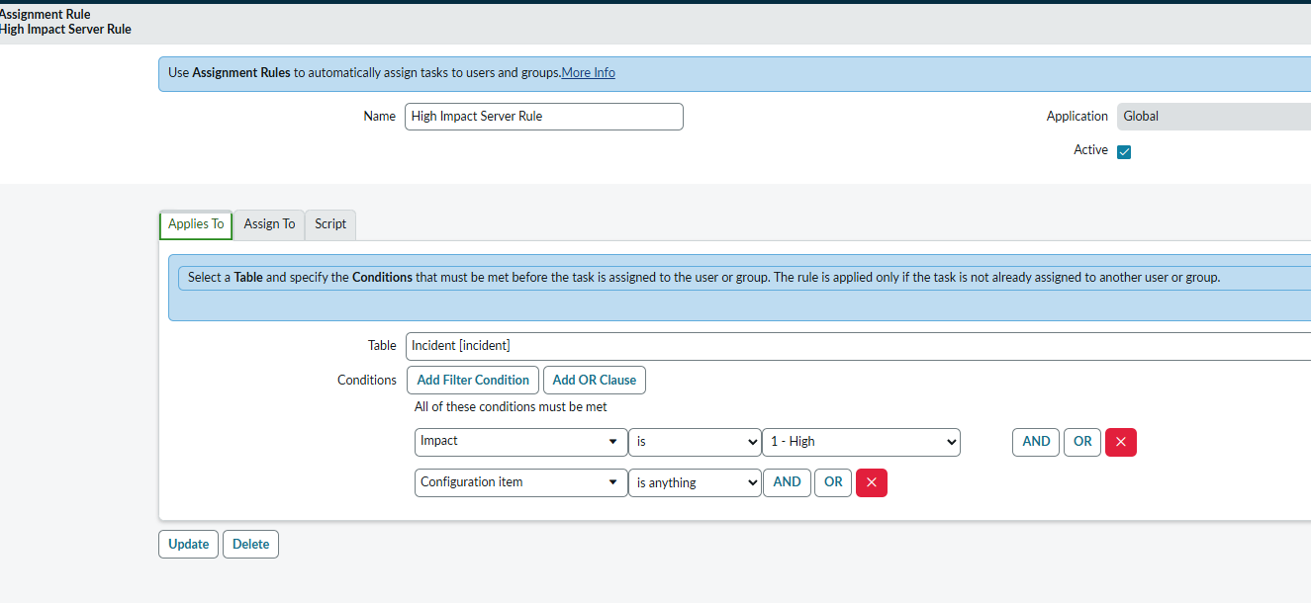
Asssignment Rule on configuration item and impact

Slide 6
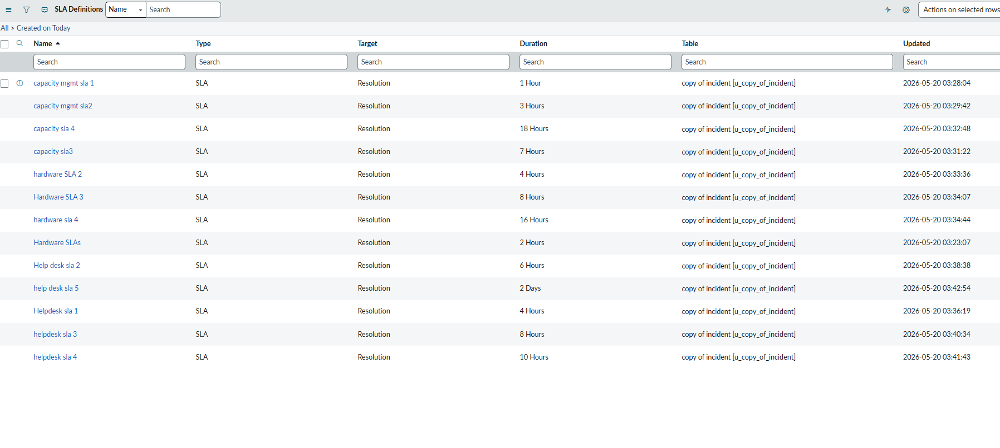
SLA Requirements: Test whether we can design SLA for a Custom table-copy of incident table which extends task table for sla configuration

Slide 7
Reports Requirements:
Name : Group Manager - Incidents by Assignment
Description:
Create a report for the incident table on state New,onhold,In Progress based on assignment group manager.
Type : Bar
Name : Incidents created by Belgium users
Description:
Create a report for the incident table on the users created by belgium users.
Type: List
Name : Incident Trending from Jan 2016 to today
Description: Create a report for the incident table records created from 2016 to till now.
Type : List
Name : Open Incidents by Priority
Description: Create a report for the incident table on the priority basis.
Type : Pie
Name : HardwareIncidents - Last 30 days
Description : Create a report on an incident table for a hardware group created in the last 30 days.
Type: Heatmap
Name : Incidents Opened Today
Description : Create a report on incident table opened on today
Type: Single sore
Name : All Incidents Closed By (My Groups)
Description : Create a report on the incident table closed by assignment group where logged in user part of.
Type: Bar
Name : Incidents not updated for 7 days
Description : Create a report on incident table which were not updated since 7 days
Type: Sigle score
Name: Incidents related to Causing Changes
Description : Create a report on the incident table which is causing change.
Type: List
Name : Unassigned Incidents
Description : Create reports on the incident table that are not assigned to any user.
Type : Sigle score
Create a dashboard and attach all these reports to it.

Slide 8
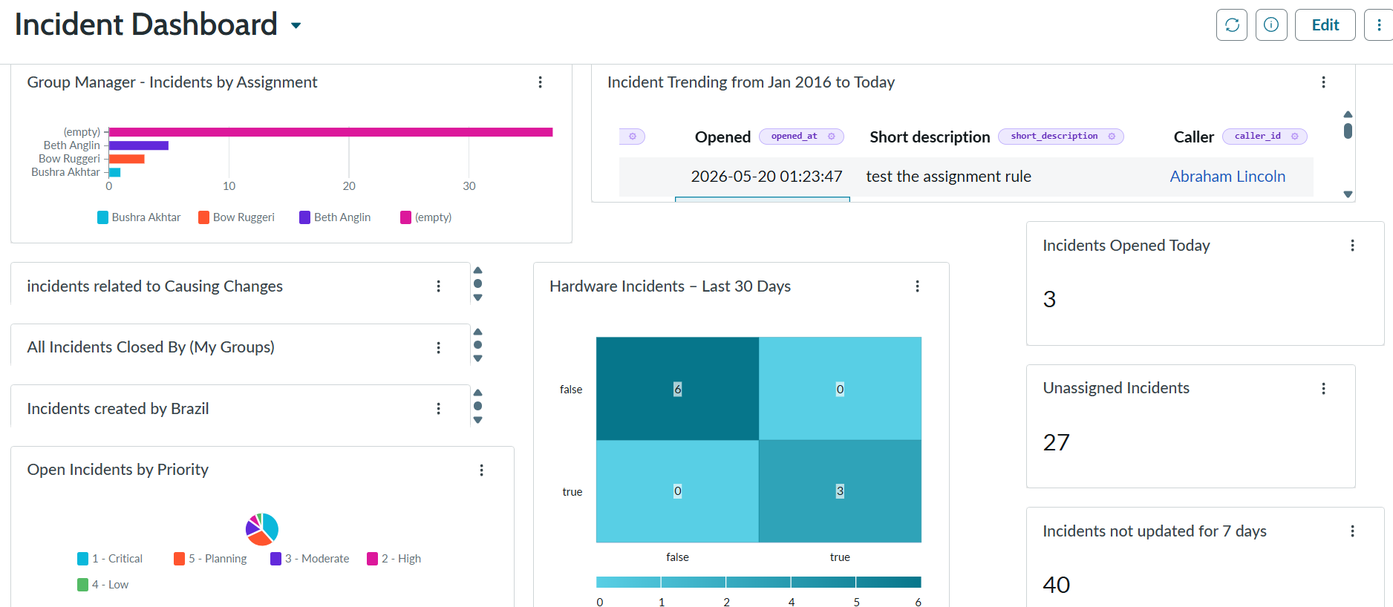

Slide 9
